Slide 1
Industry Panel Agenda
April 18, 2024
OEM / CPI / Industry News
VOC Team Update
Durability Team Update
Bolster Team Update
2024 Survey (Need more responses)

Slide 2
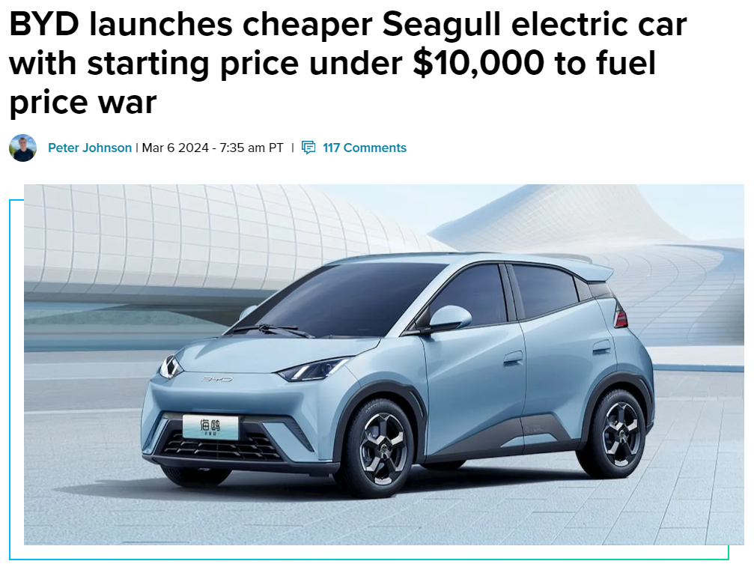
https://insideevs.com/news/710364/byd-detroit-import-seagull-caresoft/

Slide 3
Thank you

